Slide 1

E COMMERCE SITES RECOMMENDATION SYSTEM USING MACHINE LEARNING
Under the esteemed guidance of
Dr.S.Siva Nageswara Rao ,B.Tech,M.Tech.Ph.D
Professor
Team members
D.Trinadh (19471A05L2)
K.Chaitanya (19471A05M2)
T.Manikanta ( 20475A0519)

Slide 2
ABSTRACT
With the development of information technology, people are likely to choose products through online-shopping platform as it’s so convenient to select products based on their reviews. Even for popular products, thousands of reviews are posted on e-commerce sites.
That makes it difficult for online consumersto make purchasing decisions based on all the reviews. In order to help consumers make purchase decisions, it is a valuable research topic to rank the products through products’ information.
For the purpose ofobtaining more objective and accurate order of products, in this paper, we propose a prospect theory-based method to rank the products by integrating online product scores and objective data. Alternative products are obtained according to the customers’ basic product requirements.
Then, online scores and objective valuesof alternative products based on multiple criteria are collected and fused after the normalisation procedure. Finally, we get the ranking of alternative products according to the weighted prospect values of alternative products based on multi-criteria.

Slide 3
Literature Survey
INTRODUCTION
With the popularization of the Internet, shopping onlinehas been accepted by more and more people.
The newshopping experience and convenient consumption mode hasbecome the first choice of more and more people. Since2009, business applications represented by shopping, onlinepayment and travel reservation have been growing rapidly.
These have led to the development of other Internet applications and these applications have become the prominentcharacteristics of China’s Internet development.
More andmore e-commerce websites have provided channels for con-sumers to purchase products. For example, Amazon (http://www.amazon.cn/), Taobao (https://www.taobao.com/), Jingdong Mall (https://www.jd.com/), and Automobile.

Slide 4
SYSTEM REQUIREMENTS
HARDWARE REQUIREMENTS
Processor : Intel(R) Core™2 i7-5500U CPU @2.50GHz
RAM : 8GB(gigabyte)
System Type : 64-bit operating system, x64-based processor
SOFTWARE REQUIREMENTS
Browser : Any Latest browser like Chrome
Operating System : Windows 10
Language : Python
Platform : Google COLAB

Slide 5
EXISTING SYSTEM
In the existing studies, text-based online reviews are oftenconverted to different forms based on numbers, such as realnumbers, triangular fuzzy numbers, intuitionistic fuzzy num- bers and probabilistic linguistic term sets.
In the process ofanalyzing customer evaluations, Kang and Park [25] con- verted the data generated by customers into real numbers tomeasure customer satisfaction. Pengetal.
used triangu-lar fuzzy numbers to express buyers’ opinions on alternative products.
further used intuitionistic fuzzynumbers to represent the performances of possible products in terms of key features. converted a large number of online comments based on emotional into an interval-value intuitionistic fuzzy number. Recently,Liu and Teng [29] convertedsentiment classifier of onlinereviews into probabilistic linguistic term sets.

Slide 6
PROPOSED SYSTEM
This study proposes an approach to rank alternative prod-ucts by combining subjective and objective information ofproducts based on the prospect theory.
The information representation models and ranking methods for alternative products are reviewed in this section.
STEPS
Data collection
Data preprocessing
Feature selection
Model selection
Model training
Model evaluation

Slide 7
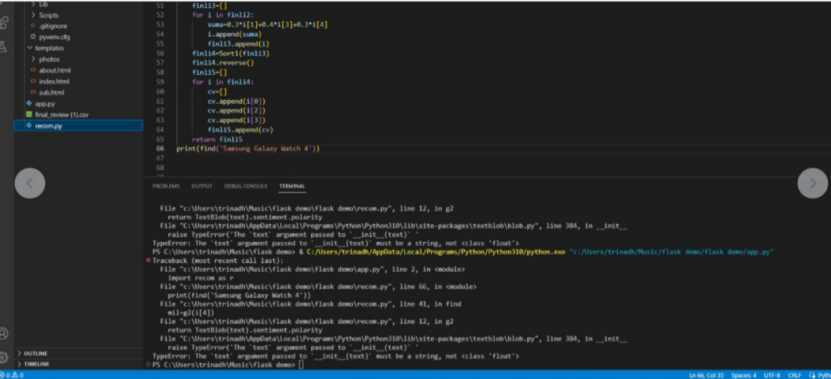
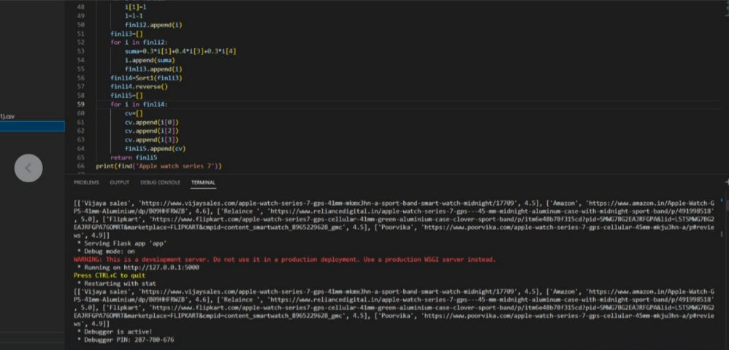
TESTING
Test screen 1
Test screen 2

Slide 8
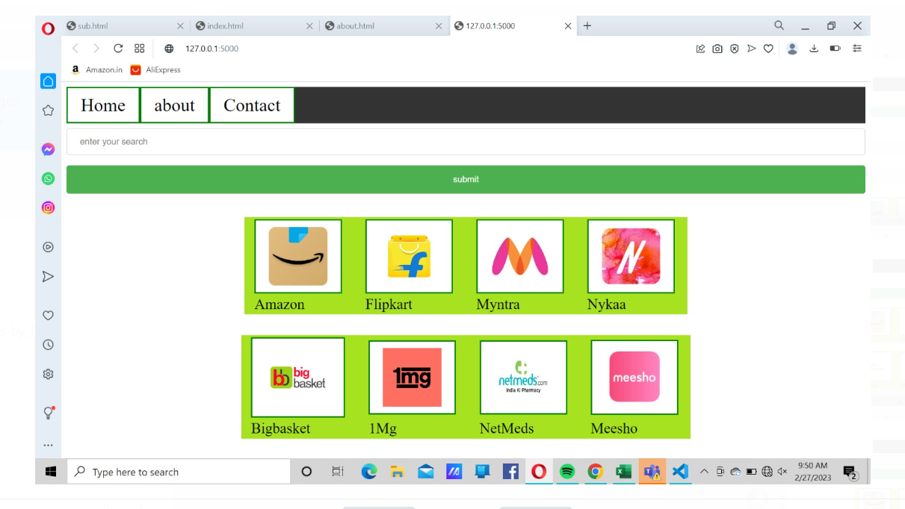
Output Screens

Slide 9
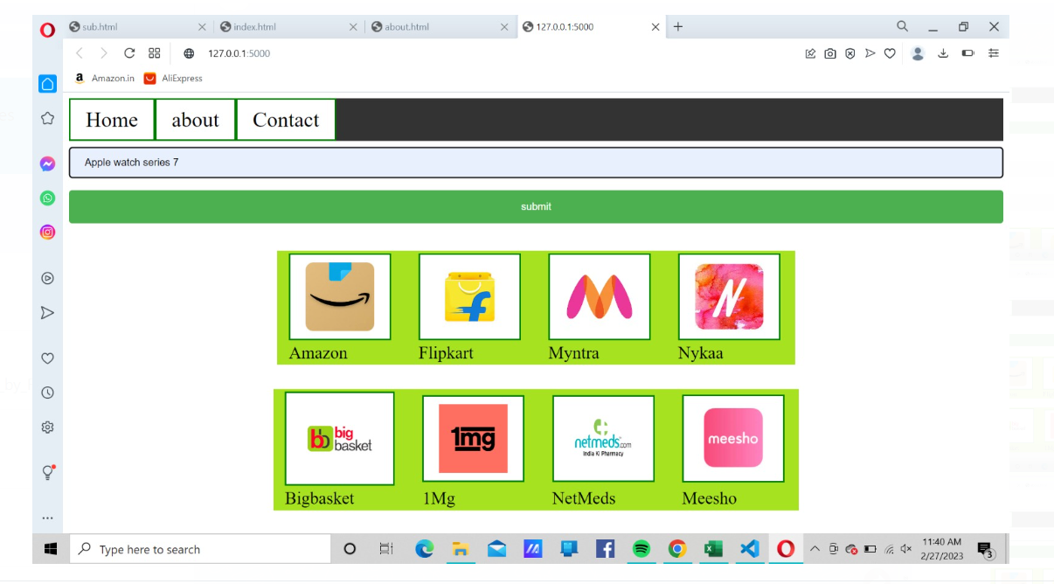

Slide 10
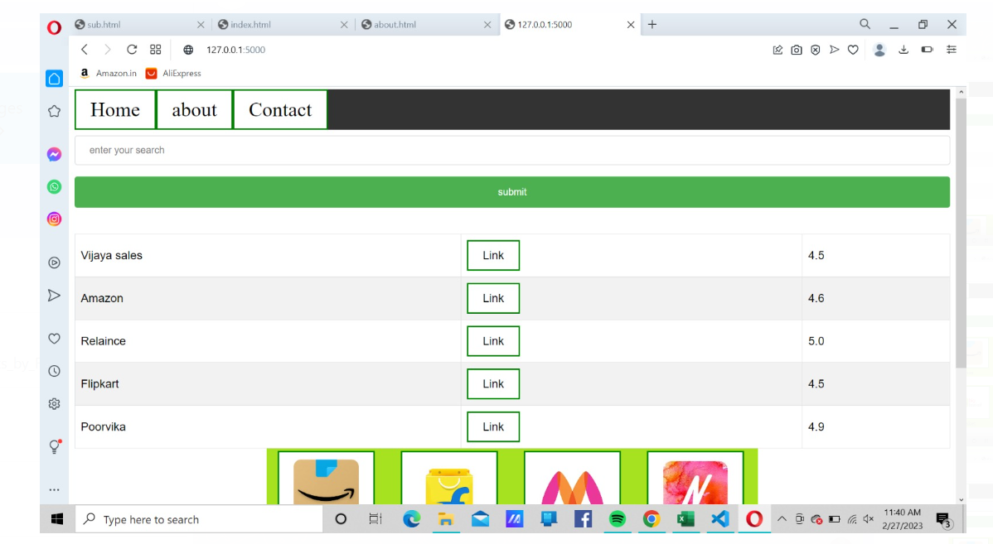

Slide 11
CONCLUSION
This paper presents an approach to rank alternative products based on prospect theory by combining online scoringand objective indicator data.
In the approach, online scoresand objective data of alternative products concerning the criteria are collected on online-shopping site. Then, fusingproduct information about each product criteria is established according to subjective and objective information.
the weighted prospect values of the alternative products arecalculated based on consumers’ preferences, and a rankingof the alternative products is determined and recommended to the consumers.

Slide 12
THANK YOU

